Slide 1


Team Number: DC20075
Dataset: Ocean Cleanup
Connor Howard, Christopher Smith, Yixin Ye
https://github.com/privat33r/dc20075-ocean

Slide 2
Assumptions About Dataset
Each piece of garbage collected was a whole piece
Each person in a group does equal amount of work
Each person only participated in one event
Each person walks and picks up trash at same pace

Slide 3
Data Preparation
Dataset is input by any person who has the app, so there is a greater chance for error
Went through and eliminated all outlier data, such as a single person picking up a single piece of trash weighing 10,000 pounds
Gathered 2019 U.S. population estimates from the U.S. Census Bureau

Slide 4
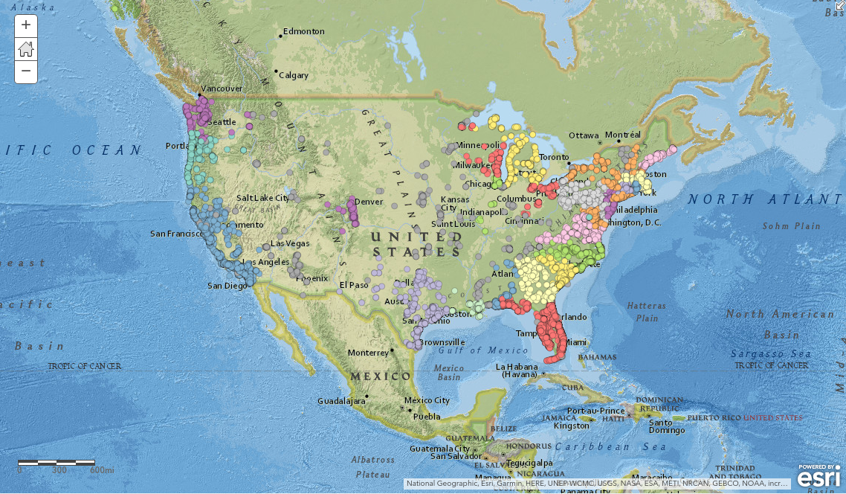
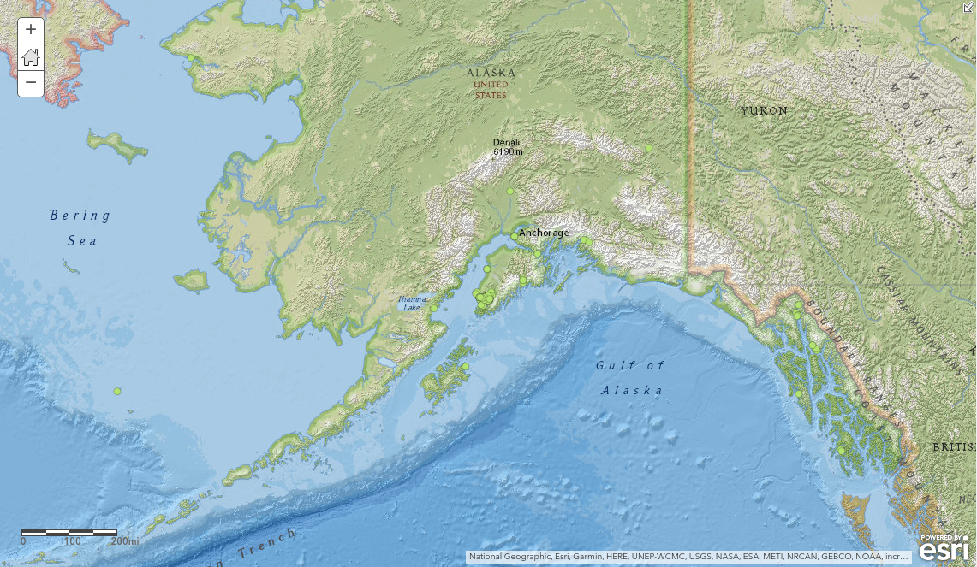
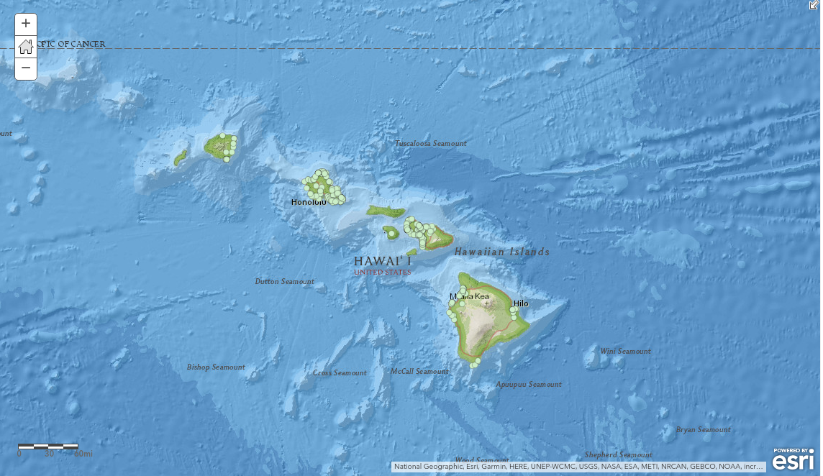
Locations of Trash Cleanups
http://arcg.is/0zOzWC

Slide 5
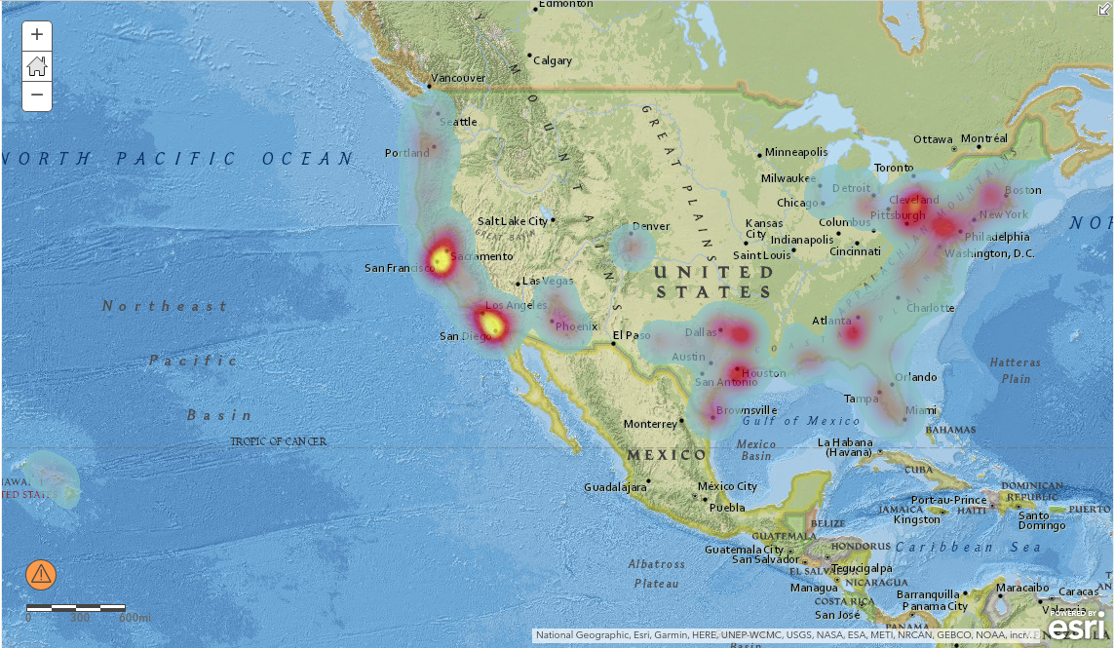
Concentration of Trash by Pounds Collected

Slide 6
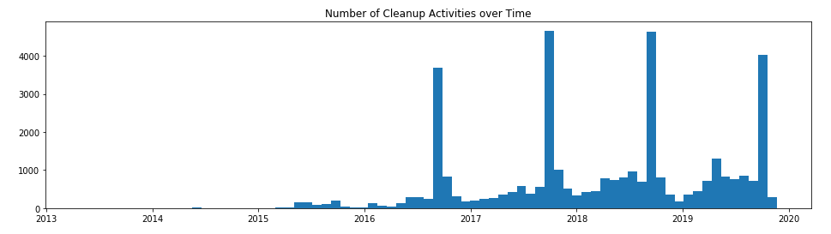
Number of Events by Month

Slide 7
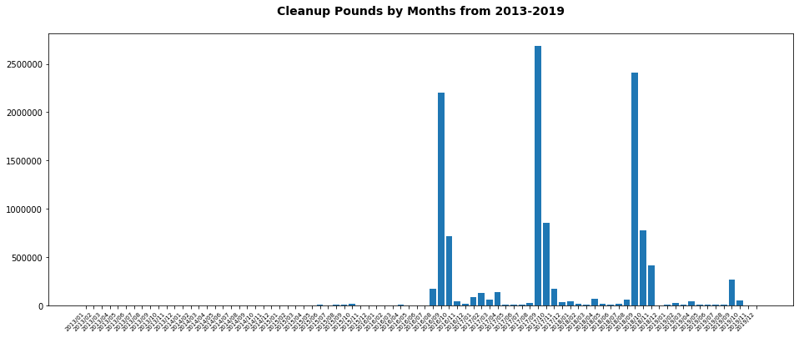
Pounds Per Month

Slide 8
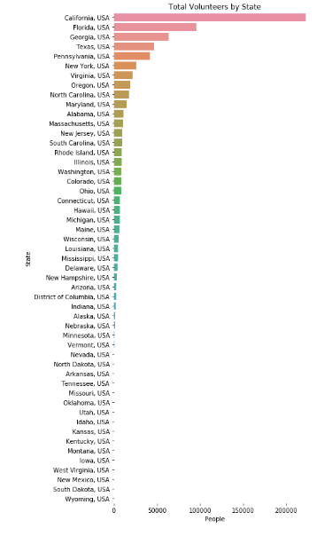
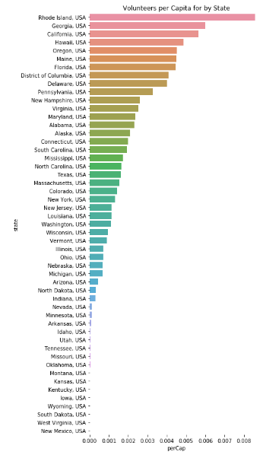
Volunteers by State
State Population taken from 2019 Population Estimates by U.S. Census Bureau

Slide 9
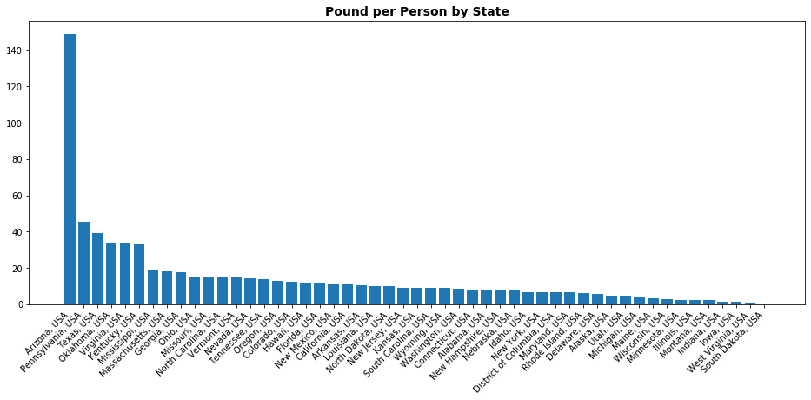
Pounds Per Person for Each State

Slide 10
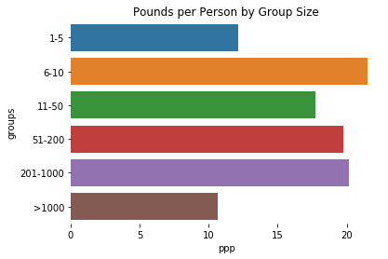
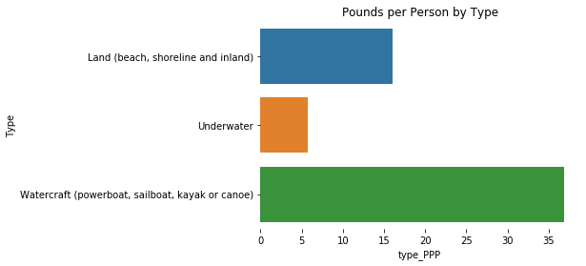
Effective Group Sizes/Cleanup Types
Effectiveness measured by pound per person

Slide 11
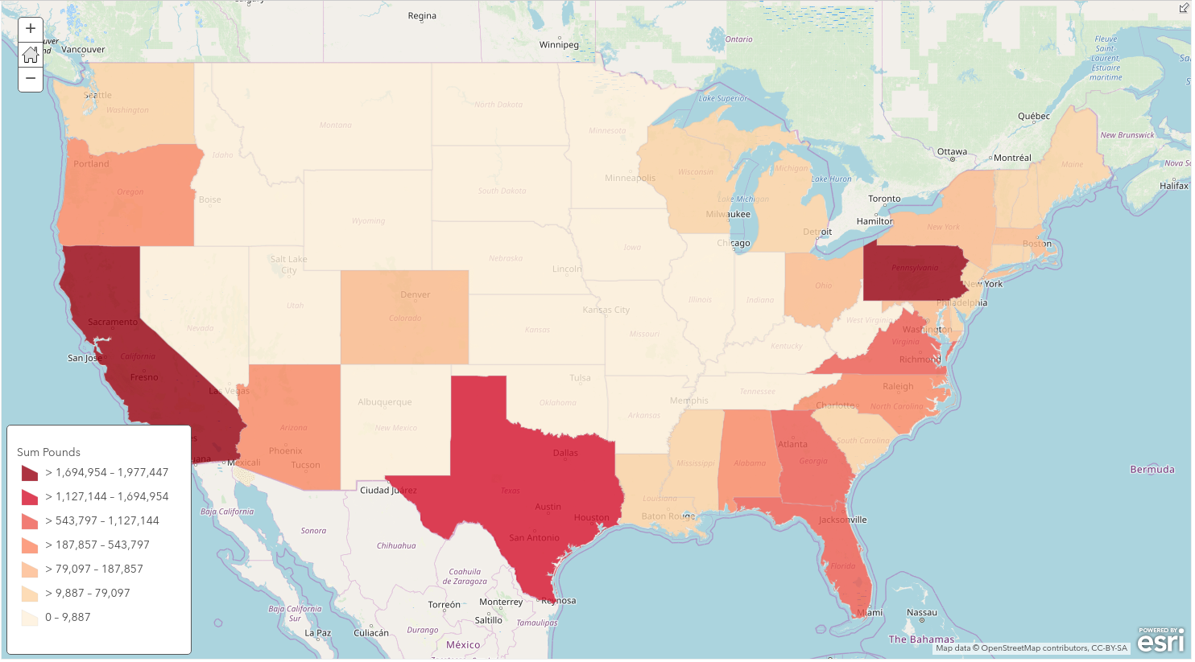
Volume of Garbage Collected by State
http://arcg.is/19GqXC

Slide 12
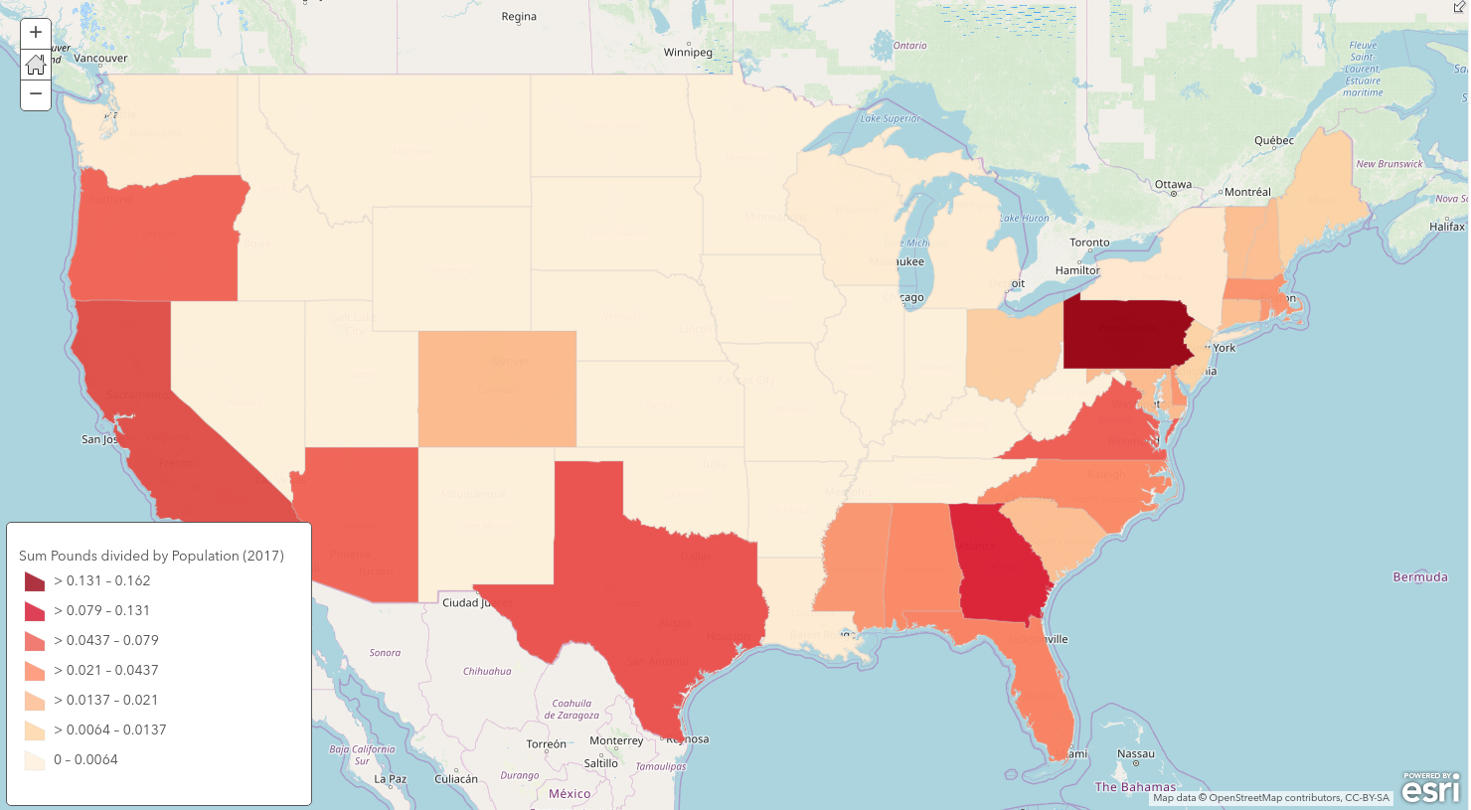
Garbage Volume Collected Per Capita

Slide 13
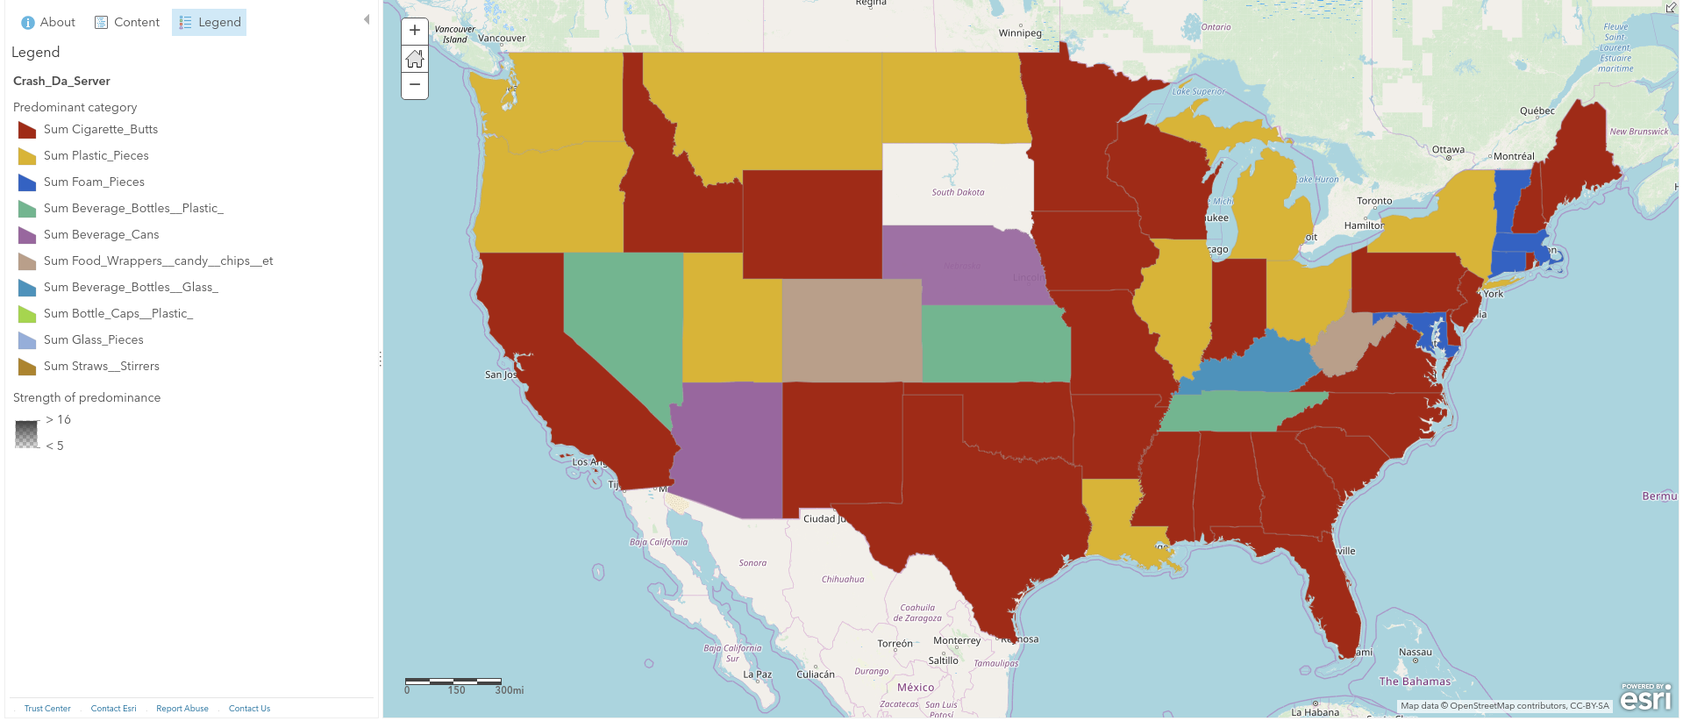
Most Common Trash Item for each State

Slide 14
Related Items (K-nearest Neighbors)
Cigarette Butts:
Food Wrappers (candy, chips, etc.)
Bottle Caps (Plastic)
Beverage Bottles (Plastic)
Glass Pieces
Straws, Stirrers
Bottle Caps (Metal)
Beverage Bottles (Glass)
Take Out/Away Containers (Foam):
Cups, Plates (Foam)
Cups, Plates (Plastic)
Cups, Plates (Paper)
Tobacco Packaging/Wrap
Paper Bags
Construction Materials
Forks, Knives, Spoons
Fishing Net & Pieces:
Fishing Buoys, Pots & Traps
Cigarette Lighters
Condoms
Appliances (refrigerators, washers, etc.)
Syringes
Diapers
Personal Hygiene (Clean Swell)
Tampons/Tampon Applicators:
Syringes
Condoms
Appliances (refrigerators, washers, etc.)
Cigarette Lighters
Diapers
Personal Hygiene (Clean Swell)
Toys

Slide 15
Sustainability
The success and improvement of ocean and waterway cleanups depends on continued involvement of volunteers and outreach to communities
Garbage pickup in waterways improves quality of life for wildlife and the serenity of the area, as well as improving water quality over time
Outreach to communities near waterways, watersheds, and beach communities can improve the number of volunteers and the success of cleanup operations
Volunteer operations prevent the need for major government intervention and can greatly improve health and use of major bodies of water

Slide 16
Potential for Future Growth
Coastal cities were major source of garbage cleanup
Areas such as the Allegheny River were major clusters of cleanup due to annual outreach and events, along with dedicated volunteers
Interior waterways, especially major rivers and estuaries and rivers, represent an area of growth that is not utilized
Mississippi, Ohio, and Missouri river show few cleanup efforts, but represent a large volume of water flow into the Atlantic and Gulf of Mexico
Water flow can bring garbage to oceans and river deltas
Locations for outreach focus can be major metropolitan areas in the Midwest, such as St. Louis, Chicago, Memphis

Slide 17
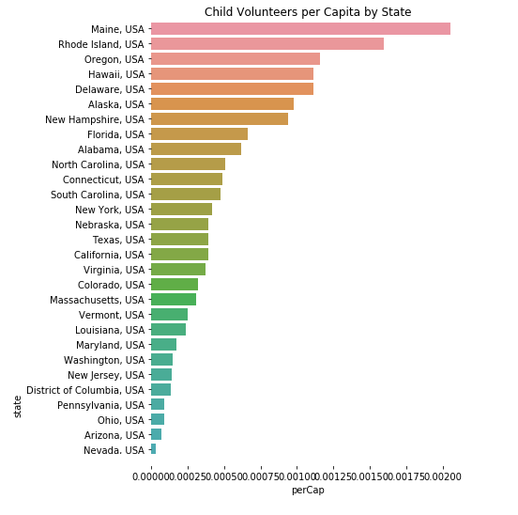
Education/Outreach
Outreach to children allows for better long-term involvement and influence in cleanups
Maine, Rhode Island, Oregon, Hawaii, Delaware, Alaska and New Hampshire are the leading states in getting children involved in cleanups

